Slide 1

Vibe Hackathon

Slide 2


MISTRAL Vibe Hackathon - Paris
July 18th 2026
Welcome to Mistral AI Vibe Hackathon

Slide 3

MISTRAL Vibe Hackathon - Paris
July 18th 2026
This hackathon is centered around:
MISTRAL VIBE

Slide 4

MISTRAL Vibe Hackathon - Paris
July 18th 2026
Le Chat -> Mistral Vibe

Slide 5
MISTRAL Vibe Hackathon - Paris
July 18th 2026
Le Chat -> Mistral Vibe
🔗 : Tour of vibe

Slide 6

MISTRAL Vibe Hackathon - Paris
July 18th 2026
Track_01 Anything goes
– – – – – – – – – – – – – – – – – – – – – – – – – – – – – – – – – – – – –
Build anything showcasing Mistral vibe.
Create agents, skills, MCPs, cool scheduled tasks, etc… no constraints, just ship something ambitious, creative, and impactful that showcases Mistral vibe
– – – – – – – – – – – – – – – – – – – – – – – – – – – – – – – – – – – – –

Slide 7
MISTRAL Vibe Hackathon - Paris
July 18th 2026
Track_02 Improving Mistral vibe
This track is for technically strong builders who want to fine-tune Ministral, Mistral Small, Mistral Medium, Codestral, or other Mistral models on a specific task of their choosing.
– – – – – – – – – – – – – – – – – – – – – – – – – – – – – – – – – – – – –
This track is for technically strong builders who want to leverage the open codebase of Mistral vibe CLI and add some missing capacities.
– – – – – – – – – – – – – – – – – – – – – – – – – – – – – – – – – – – – –

Slide 8
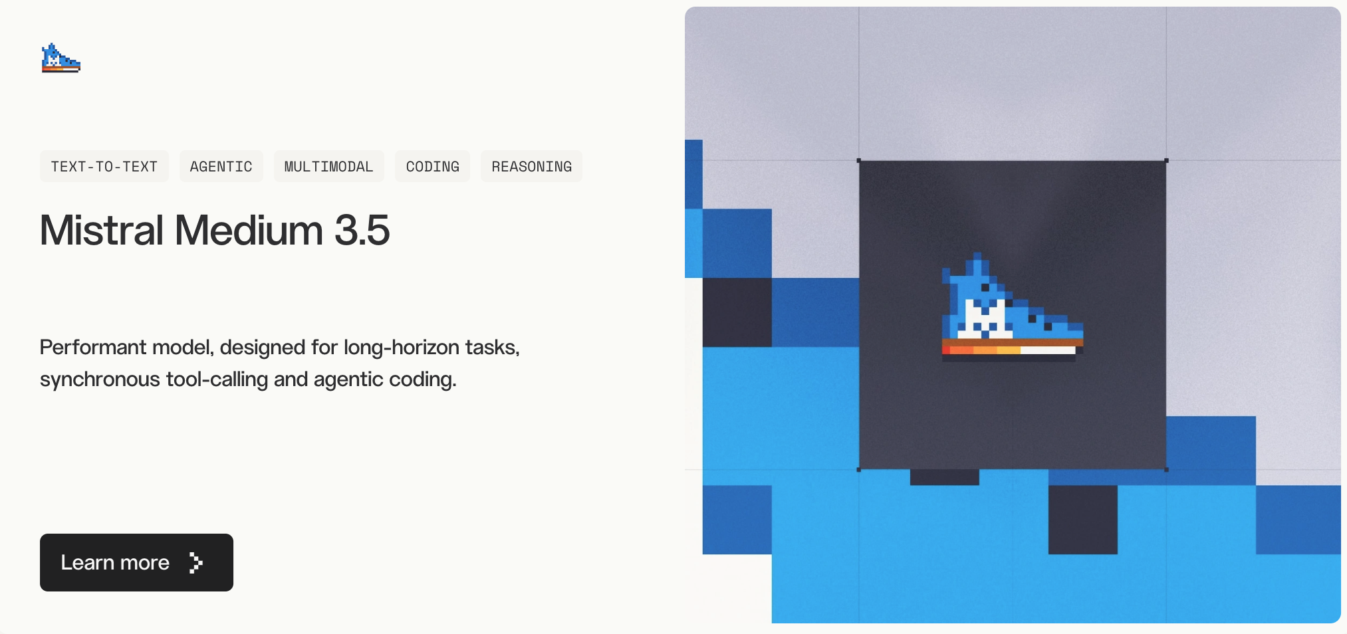
MISTRAL Vibe Hackathon - Paris
July 18th 2026

Slide 9
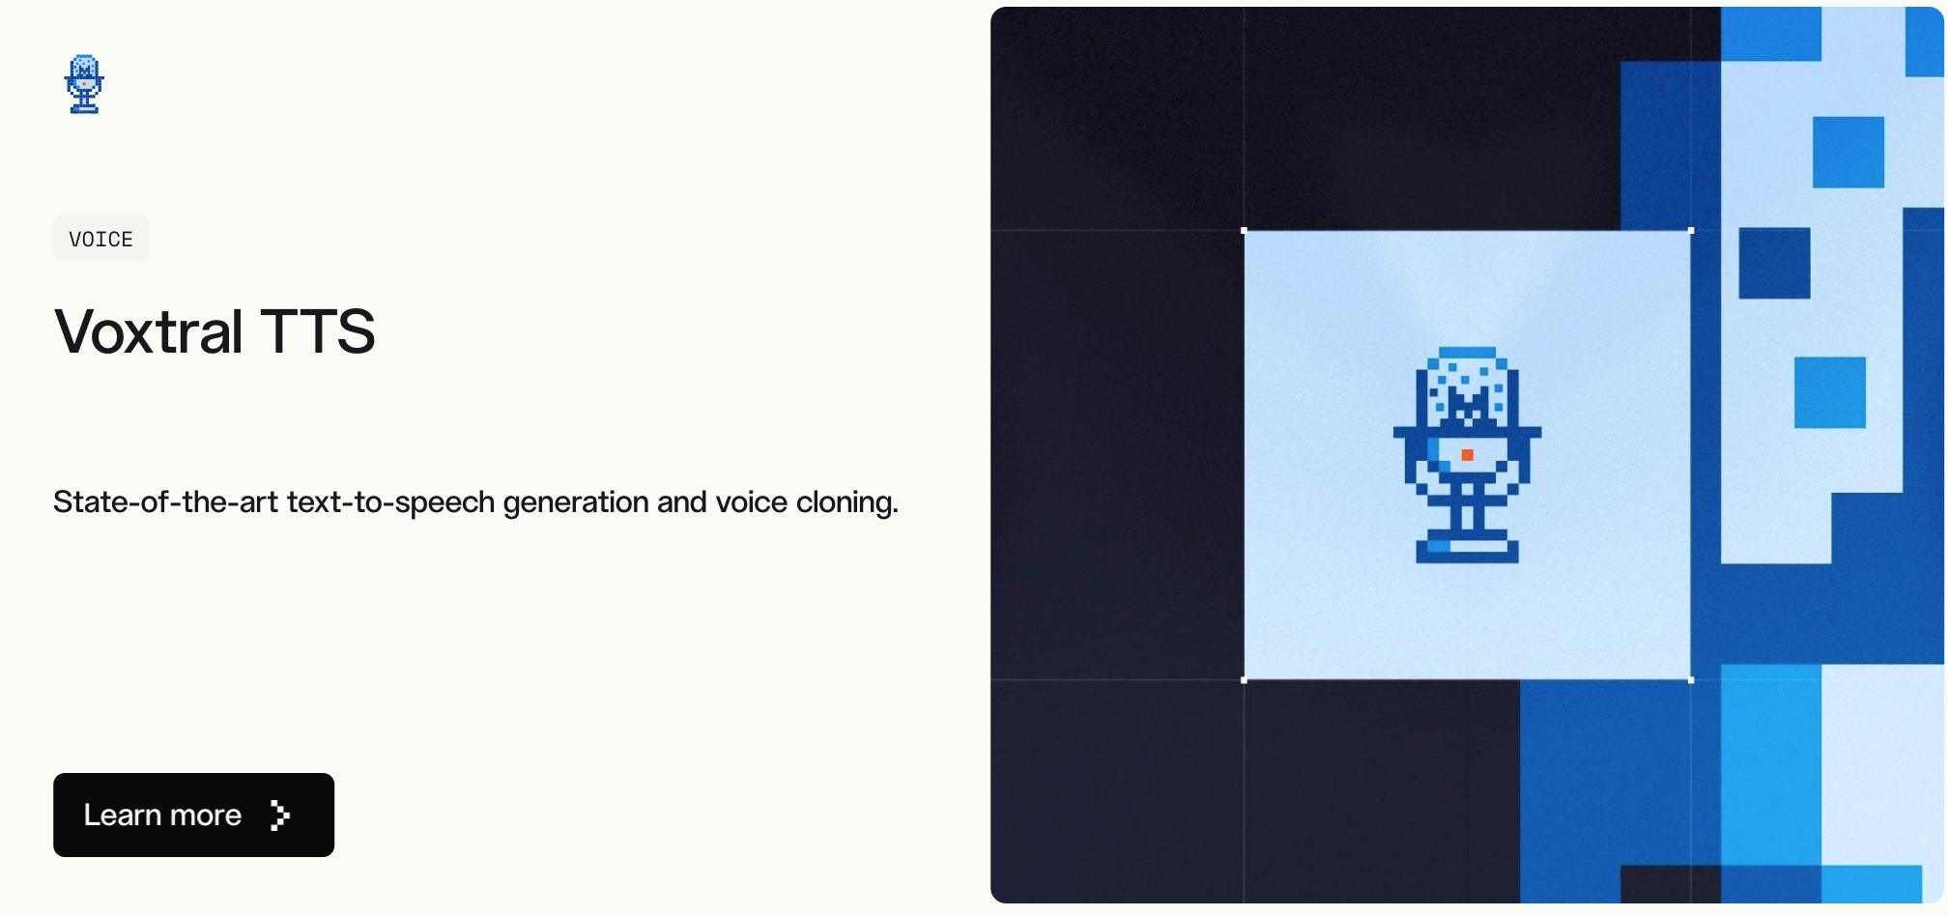
MISTRAL Vibe Hackathon - Paris
July 18th 2026

Slide 10
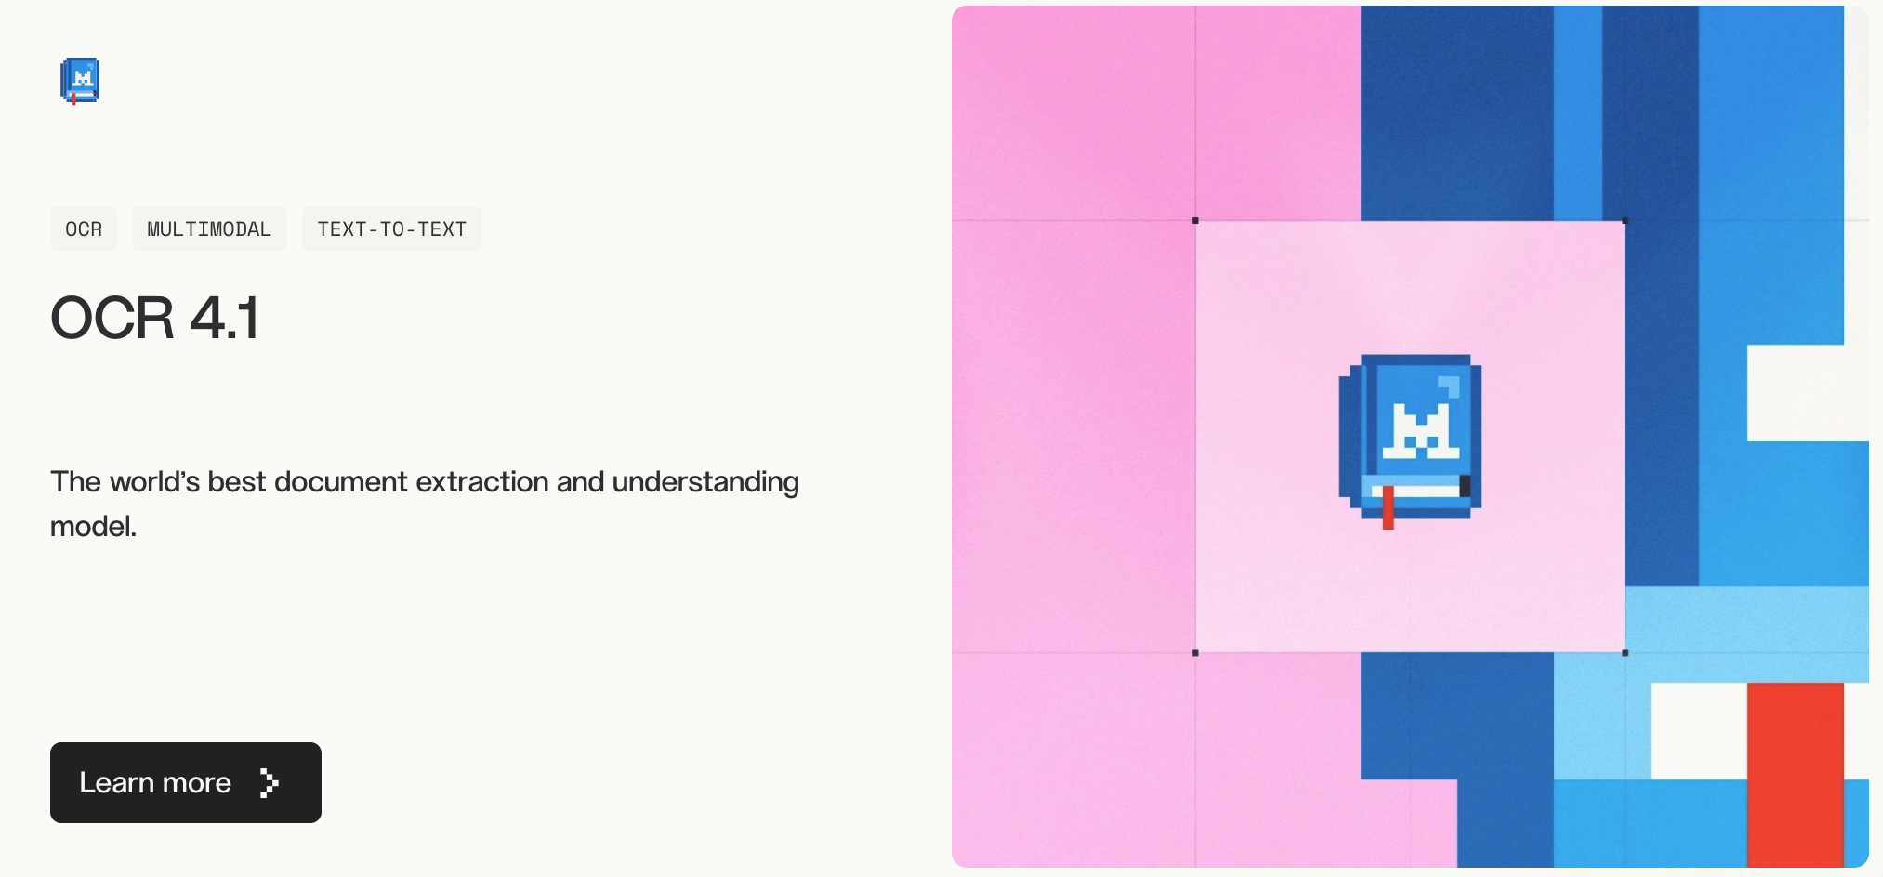
MISTRAL Vibe Hackathon - Paris
July 18th 2026

Slide 11





Mistral Workflow
Workflows
Compositional logic: the orchestration layer
Durable, deterministic process that orchestrates activities and manages execution state.
Fetch the attachments
OCR the attachments
Classify the documents
Activity
Send the email
Wait for
validation
Write an email draft
Executional logic: the atomic unit of work
Calling an external API. Running a database query. Processing a file. Generating a response from an AI model.
Queries, signals, updates
Human operator
The interaction with external systems
Interact with workflows, view status, and edit as needed (humain-in-the-loop, integration with external systems)
Notes:
What we sell and to whom:
P0 is enterprise voice infrastructure for organisations with complex voice workflows that need full data residency, model customisation, and workflow ownership through Vibe Work and custom voice agents.
P1 is vertical voice applications for enterprises with specific functional pain like wealth management, insurance, or contact centre compliance, deployed on-prem for regulated industries with a land-and-expand motion.
P2 is departmental productivity where teams deploy meeting intelligence, transcription, or voice assistants without an IT-led transformation.
Front-office:
Support voice agents handle L1/L2 triage and resolution across channels, with live builds in insurance, shipment and booking queries, and wealth management advisory.
Sales meeting intelligence provides speaker attribution, pipeline analysis, and automated follow-ups from transcribed calls.
The differentiator is real-time voice agents that actually route and resolve, with natural, brand-appropriate voice quality.
Back-office:
Compliance teams use real-time call monitoring with diarization for KYC/AML automation and audit trails with speaker attribution.
Contact centre transcription at scale feeds enterprise search and analytics, and infrastructure is often already in place so deployment is fast.
The differentiator is audio-native compliance that's real-time, diarized, and auditable.
Operations:
Contact centre infrastructure is the fastest deployment path because teams plug in the model and structured output flows through existing systems.
Real-time translation enables voice-to-voice across 10+ languages, and counselor support tools surface context to professionals mid-call without them handling audio directly.
The differentiator is on-device deployment, noise robustness, and dialect fine-tuning.

Slide 12
Mistral Workflow
Notes:
What we sell and to whom:
P0 is enterprise voice infrastructure for organisations with complex voice workflows that need full data residency, model customisation, and workflow ownership through Vibe Work and custom voice agents.
P1 is vertical voice applications for enterprises with specific functional pain like wealth management, insurance, or contact centre compliance, deployed on-prem for regulated industries with a land-and-expand motion.
P2 is departmental productivity where teams deploy meeting intelligence, transcription, or voice assistants without an IT-led transformation.
Front-office:
Support voice agents handle L1/L2 triage and resolution across channels, with live builds in insurance, shipment and booking queries, and wealth management advisory.
Sales meeting intelligence provides speaker attribution, pipeline analysis, and automated follow-ups from transcribed calls.
The differentiator is real-time voice agents that actually route and resolve, with natural, brand-appropriate voice quality.
Back-office:
Compliance teams use real-time call monitoring with diarization for KYC/AML automation and audit trails with speaker attribution.
Contact centre transcription at scale feeds enterprise search and analytics, and infrastructure is often already in place so deployment is fast.
The differentiator is audio-native compliance that's real-time, diarized, and auditable.
Operations:
Contact centre infrastructure is the fastest deployment path because teams plug in the model and structured output flows through existing systems.
Real-time translation enables voice-to-voice across 10+ languages, and counselor support tools surface context to professionals mid-call without them handling audio directly.
The differentiator is on-device deployment, noise robustness, and dialect fine-tuning.

Slide 13


MISTRAL Vibe Hackathon - Paris
July 18th 2026
Prizes
1st Place
2nd Place
3rd Place
$3,000 MISTRAL AI CREDITS
$2,000 MISTRAL AI CREDITS
$1,000 MISTRAL AI CREDITS

Slide 14
MISTRAL Vibe Hackathon - Paris
July 18th 2026
Judging process
You must submit your project by the deadline 6pm. With a demo video showcasing your projects. More details will be posted on discord.
2. We will then divide all submissions into groups and you will present live in front of the jury your project (5 min.) Free format ! Present however you feel most comfortable.
3. The jury will deliberate and come back with the finalists. The finalists will present their project in front of everyone (5 min.)
4. We will announce the winners!!!

Slide 15

MISTRAL Vibe Hackathon - Paris
July 18th 2026
Agenda
08.30-9.30am - Door open + Breakfast 9.30-10am - Opening Ceremony & Launch
12.30pm - Lunch 04pm - Snacks
05.30pm - Submissions due
~07.30pm - Winner announcements

Slide 16


MISTRAL Vibe Hackathon - Paris
July 18th 2026
Get your credits
Click this link: https://mistral-credits.fly.dev/h/vibe-sf-2026
password : vibing
Log in on AI Studio and claim your credits
* Registrations made with multiple email address will not be accepted.

Slide 17
MISTRAL Vibe Hackathon - Paris
July 18th 2026
hosted by
Let’s Hack!
WIFI SFHQ SFHQ2024!

